Slide 1
Semaa | Oyen’kwa’on:we | Kwshahtew | Tobacco
Community-Based Governance Initiative

Slide 2
Indigenous Consciousness
“Spirituality is the highest form of political consciousness”
Notes:
Poster – “IDIG”

Slide 3
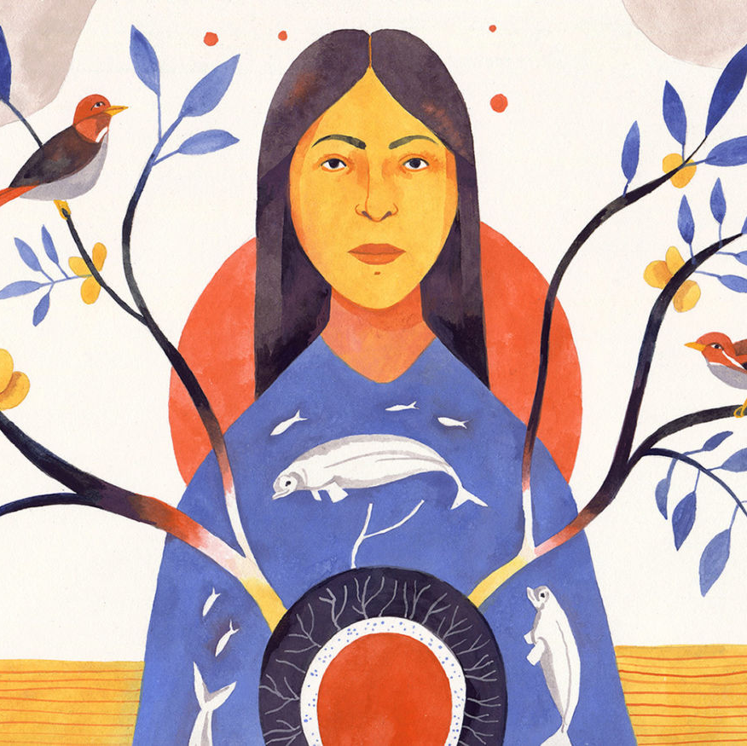
Indigenous Governance
Rooted in spirituality, traditions, and stories
Respect and responsibility to all of Creation
Knowledge and connection to place
International relations, trade, and diplomacy
Collective responsibilities/inherent rights relationships, justice, and life ways
Participatory decision making

Slide 4
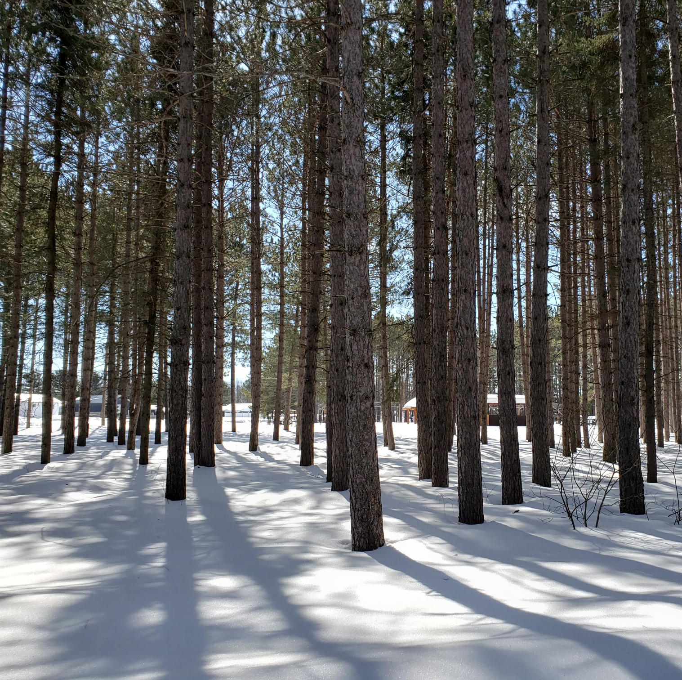
Community Growth
We have been moving away from western programs & services towards culturally appropriate services
Families and communities are embracing culturally appropriate services and want to move towards culturally-based activities
Moving beyond reserve concepts to understandings of original lands

Slide 5
Community Growth
We are confronting the myths about our People and replacing this with a cultural image of ourselves
Despite the years of authoritative behaviour of government, we are choosing our own future

Slide 6
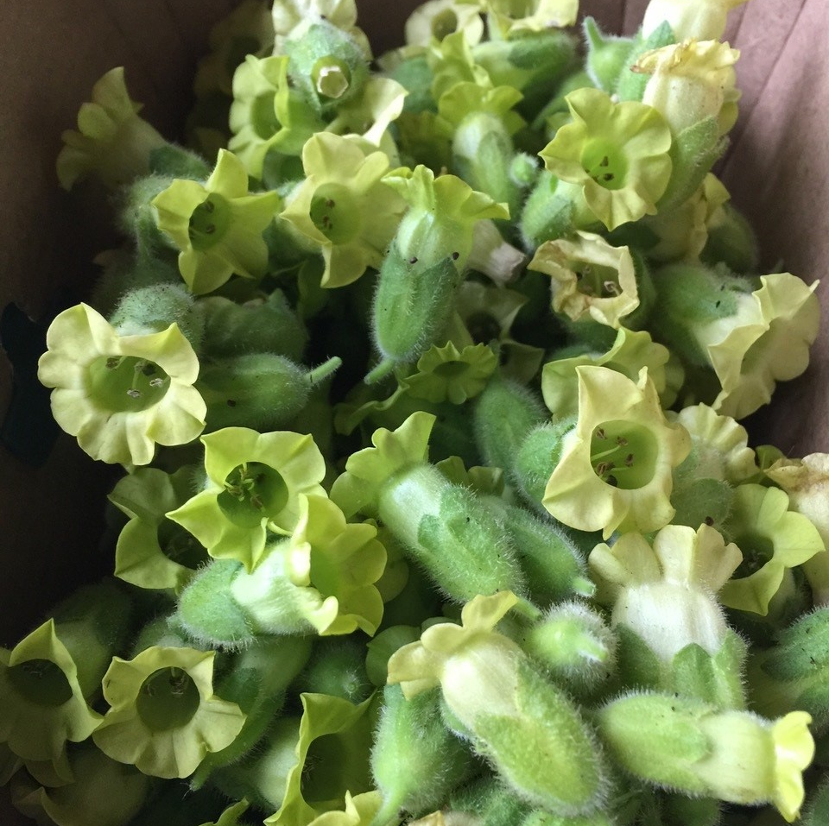
Tobacco & Law-Making: Community-Based Governance Initiative
Building community capacity for governance & community decision-making
Regulations for tobacco that are in alignment with the Nations’ views of tobacco, trade, & commerce
Shifting away from western practices towards and our own cultural foundations and legal systems

Slide 7
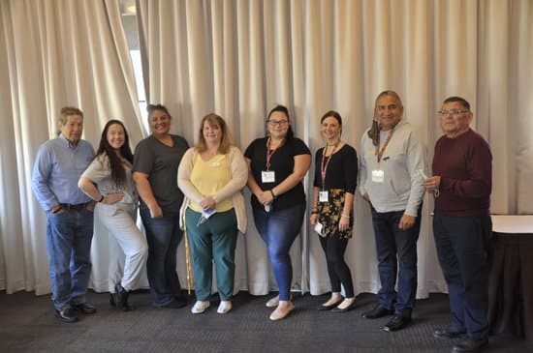
AIAI Tobacco Task Force
One rep per Nation
The critical community link for hands-on discussion
Provide direction for collective project work
Community education & communication role
Working link getting the project off the ground in the communities
Community workplans

Slide 8
What We’ve Heard
“We need to be able to talk to one another and have community education to ensure transmission of knowledge and of our systems/laws.”
“We need to educate our communities on the fact that external governments do not have ability to control us. We have to keep strengthening our message to our communities saying, yes, we have our own jurisdiction. We have to break out of the colonial mindset.”
“We can choose to not participate in certain systems and determine how we can replace those systems. We need to begin to address legislative and policy blockages so our own laws can take precedence in our worlds and as we relate to Crown institutions.”
“We need to educate our governments and others advocating on our inherent rights.”

Slide 9
“It is important to be able to get to the place of knowing we have our own ability to assert and to stop giving our energy away to the wrong systems of laws.”
“We should do more to raise awareness of Indigenous Peoples’ inherent ability to impose law and we should be celebrating each other on our efforts and successes at minimizing foreigners’ law.”
“It is important to have more examples of successful assertions of jurisdiction.”
“…moving forward into our own reality and utilizing what we already have. We need to shift ourselves to this foundational understanding.”

Slide 10
What are we doing?
When we are talking about long-term systemic change, we are talking about community processes that exist or have to be built.
None of the work within this Community-Based Governance Initiative has anything to deal with settler law, rather it is about a relationship.
Tobacco is our focus, enabling the building of community capacity for all sectors

Slide 11
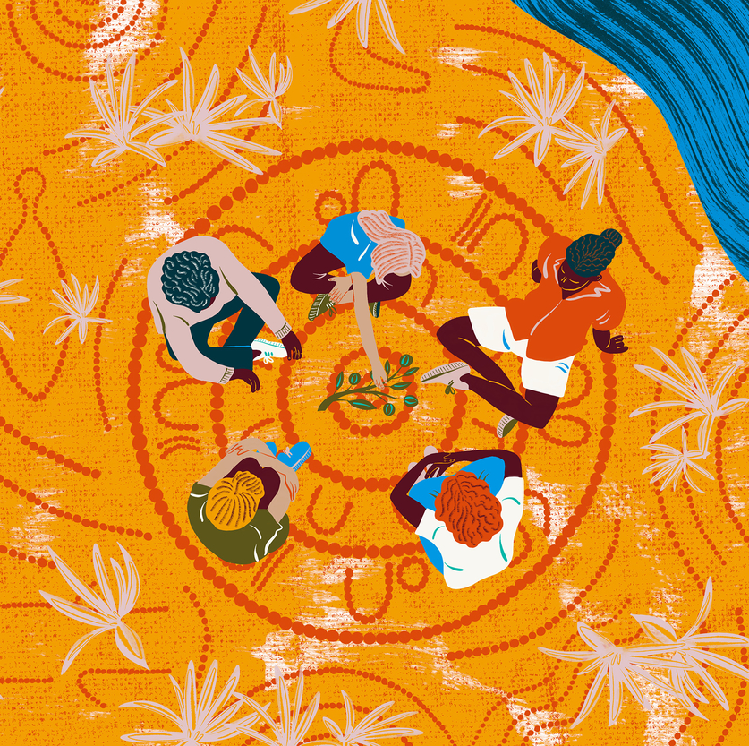
Community-led
Funding to First Nations for community capacity development
Community work plans:
Communications & dialogue around project topics
Workshops & information sharing initiatives
Community-specific information and research
Governance workshops & community-decision-making exercises
Community forums and feedback processes
Community planning & prioritization

Slide 12
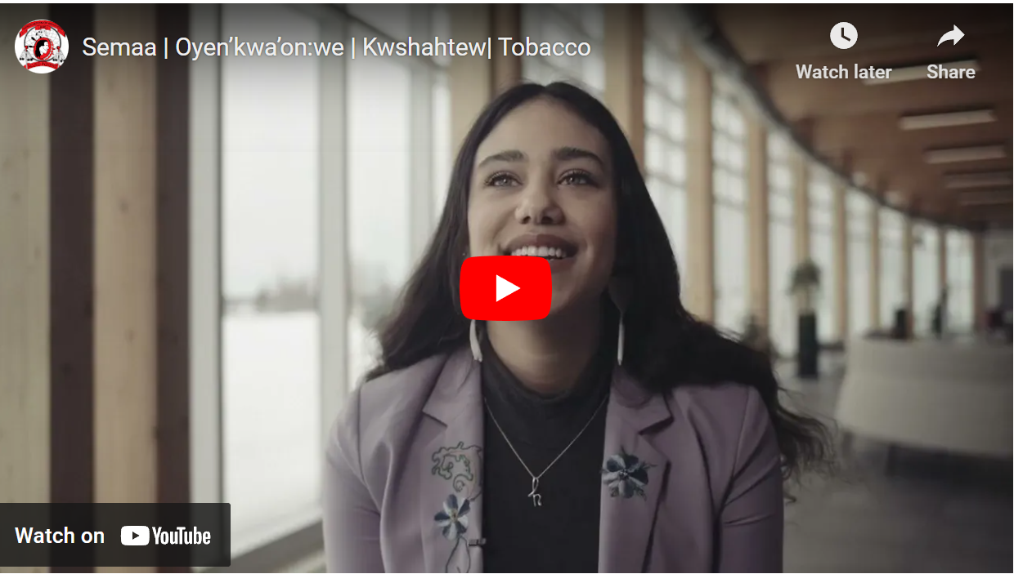
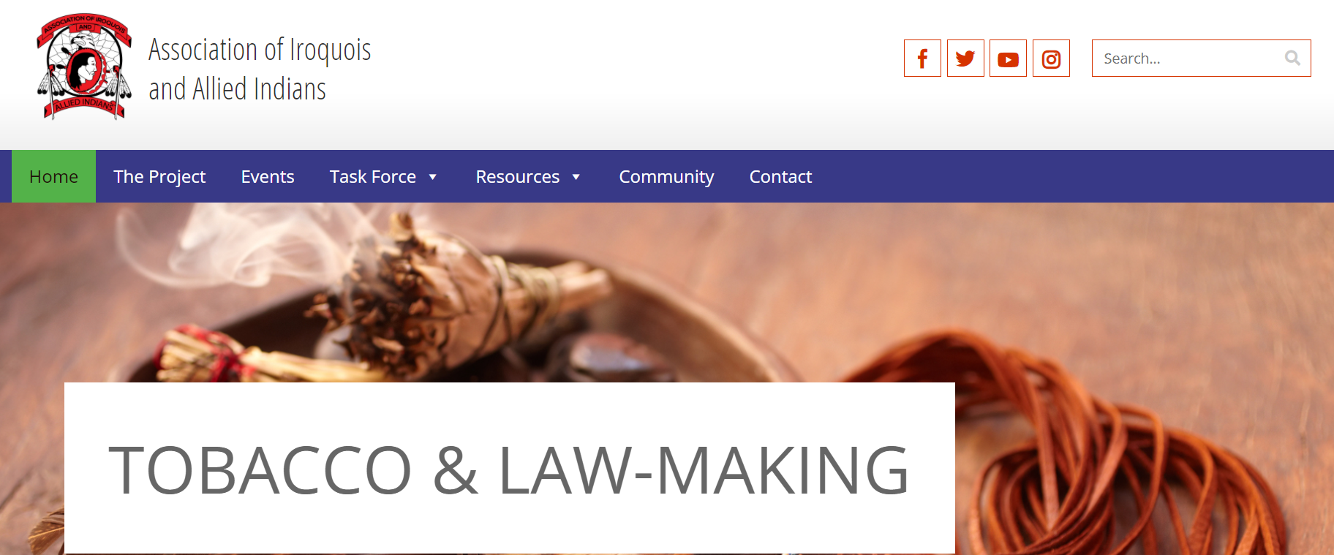
Information Sharing
Website: https://tobacco.aiai.on.ca/
Videos
Tobacco & inter-Nation trade
Law-making
The importance of language & culture
Sovereignty/never-ending responsibility
Community booklets
Inter-Nation trade

Slide 13
Tobacco, Trade, & Commerce: A Discussion Paper
Captures vision, positions, and definitions.
Outlines areas of consideration & potential approaches for moving toward negotiations.
Serves as base for development of community education & communication materials.
Including languages and cultural approaches as much as possible.
Notes:
Last working session was January 2022 with Task Force.

Slide 14
Ongoing Collective Work
Commission components outline
Mutual benefits for communities and businesses
Legal & economic research
Finalize internal negotiations terms sheet
Negotiations training

Slide 15
AIAI Tobacco Task Force Representatives
Chief Dean Sayers Batchewana First Nation
Michelle McCormack Caldwell First Nation
Chief Denise Stonefish Eelunaapeewi Lahkeewiit
Chief Todd Cornelius Oneida Nation of the Thames
Chief R. Don Maracle & Lisa Maracle Mohawks of the Bay of Quinte
Chief Philip Franks Wahta Mohawks
Amy Bickmore Hiawatha First Nation
Arielle Strength AIAI Youth Rep

Slide 16
"To convince people it is possible to move beyond the Indian Act [and] believe in our own system of government... All the community members need to have input...and have some type of ownership of the solution put forward."

